Slide 1
Nehemiah

Slide 2
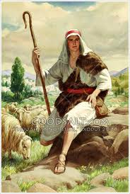
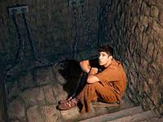
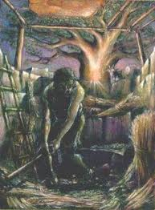
Nehemiah

Slide 3
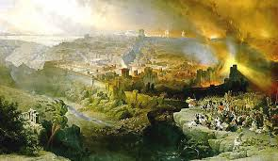
Nehemiah

Slide 4
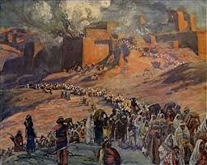
Nehemiah

Slide 5
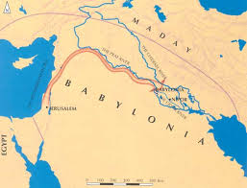
Nehemiah

Slide 6
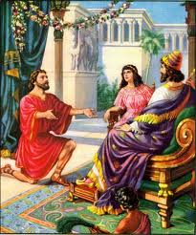
Nehemiah

Slide 7
Nehemiah
Nehemiah and God
“O LORD, God of heaven, the great an awesome God who keeps his covenant of love with those who love him and obey his commands…”
“God of heaven” = God of the covenant

Slide 8
Nehemiah
Nehemiah and God
“O LORD, God of heaven, the great an awesome God who keeps his covenant of love with those who love him and obey his commands…”
“God of heaven” = God of the covenant
“Awesome”

Slide 9
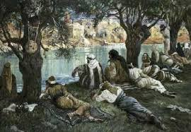
Nehemiah
Nehemiah and God
“O LORD, God of heaven, the great an awesome God who keeps his covenant of love with those who love him and obey his commands…”
“God of heaven” = God of the covenant
“Awesome”

Slide 10
Nehemiah
Nehemiah and God
“O LORD, God of heaven, the great an awesome God who keeps his covenant of love with those who love him and obey his commands…”
“God of heaven” = God of the covenant
“Awesome”
Holy – Nehemiah acted out of reverence

Slide 11
Nehemiah
Nehemiah and God
“O LORD, God of heaven, the great an awesome God who keeps his covenant of love with those who love him and obey his commands…”
“God of heaven” = God of the covenant
“Awesome”
Holy – Nehemiah acted out of reverence
"If Jesus Christ was alive today, I cannot see him, as the Christian person that he was and the great person that he was, saying this (same sex marriage) could not happen. "He was all about love and compassion and forgiveness and trying to bring people together and that is what the church should be about." (Elton John)

Slide 12
Nehemiah
Nehemiah and God
“O LORD, God of heaven, the great an awesome God who keeps his covenant of love with those who love him and obey his commands…”
“God of heaven” = God of the covenant
“Awesome”
Holy – Nehemiah acted out of reverence
- call to repentance

Slide 13
Nehemiah
Nehemiah and God
Nehemiah and Scripture
Inspiration

Slide 14
Nehemiah
Nehemiah and God
Nehemiah and Scripture
Inspiration
Education

Slide 15
Nehemiah
Nehemiah and God
Nehemiah and Scripture
Inspiration
Education
Modification

Slide 16
Nehemiah
Nehemiah and God
Nehemiah and Scripture
Nehemiah and Prayer

Slide 17
Nehemiah
Nehemiah and God
Nehemiah and Scripture
Nehemiah and Prayer
Personal

Slide 18
Nehemiah
Nehemiah and God
Nehemiah and Scripture
Nehemiah and Prayer
Personal
Corporate

Slide 19
Nehemiah
Nehemiah and God
Nehemiah and Scripture
Nehemiah and Prayer
Nehemiah and Leadership

Slide 20
Nehemiah
Nehemiah and God
Nehemiah and Scripture
Nehemiah and Prayer
Nehemiah and Leadership
Compassion

Slide 21
Nehemiah
Nehemiah and God
Nehemiah and Scripture
Nehemiah and Prayer
Nehemiah and Leadership
Compassion
Guidance

Slide 22
Nehemiah
Nehemiah and God
Nehemiah and Scripture
Nehemiah and Prayer
Nehemiah and Leadership
Compassion
Guidance
Integrity

Slide 23
Nehemiah
Nehemiah and God
Nehemiah and Scripture
Nehemiah and Prayer
Nehemiah and Leadership
Compassion
Guidance
Integrity
Vision

Slide 24
Nehemiah
Nehemiah and God
Nehemiah and Scripture
Nehemiah and Prayer
Nehemiah and Leadership
Compassion
Guidance
Integrity
Vision
Vulnerability

Slide 25
Nehemiah
Nehemiah and God
Nehemiah and Scripture
Nehemiah and Prayer
Nehemiah and Leadership
Compassion
Guidance
Integrity
Vision
Vulnerability
Delegation

Slide 26
Nehemiah
Nehemiah and God
Nehemiah and Scripture
Nehemiah and Prayer
Nehemiah and Leadership
5-point plan:
Local protection detachments (4:13)

Slide 27
Nehemiah
Nehemiah and God
Nehemiah and Scripture
Nehemiah and Prayer
Nehemiah and Leadership
5-point plan
Local protection detachments (4:13)
Reminder of God’s presence (4:14)

Slide 28
Nehemiah
Nehemiah and God
Nehemiah and Scripture
Nehemiah and Prayer
Nehemiah and Leadership
5-point plan
Local protection detachments (4:13)
Reminder of God’s presence (4:14)
Teams of workers/defenders (4:15-18)

Slide 29
Nehemiah
Nehemiah and God
Nehemiah and Scripture
Nehemiah and Prayer
Nehemiah and Leadership
5-point plan
Local protection detachments (4:13)
Reminder of God’s presence (4:14)
Teams of workers/defenders (4:15-18)
Mobile reaction force (4:19-20)

Slide 30
Nehemiah
Nehemiah and God
Nehemiah and Scripture
Nehemiah and Prayer
Nehemiah and Leadership
5-point plan
Local protection detachments (4:13)
Reminder of God’s presence (4:14)
Teams of workers/defenders (4:15-18)
Mobile reaction force (4:19-20)
Assured overall protection (4:21-22)

Slide 31
Nehemiah
Nehemiah and God
Nehemiah and Scripture
Nehemiah and Prayer
Nehemiah and Leadership
Lessons:

Slide 32
Nehemiah
Nehemiah and God
Nehemiah and Scripture
Nehemiah and Prayer
Nehemiah and Leadership
Lessons:
Facing change and challenges

Slide 33
Nehemiah
Nehemiah and God
Nehemiah and Scripture
Nehemiah and Prayer
Nehemiah and Leadership
Lessons:
Facing change and challenges
Depend on God

Slide 34
Nehemiah
Nehemiah and God
Nehemiah and Scripture
Nehemiah and Prayer
Nehemiah and Leadership
Lessons:
Facing change and challenges
Depend on God
Depend on Scripture

Slide 35
Nehemiah
Nehemiah and God
Nehemiah and Scripture
Nehemiah and Prayer
Nehemiah and Leadership
Lessons:
Facing change and challenges
Depend on God
Depend on Scripture
Depend on prayer

